Slide 1


Who owns housing policy in California?
State versus local regulatory regimes

Slide 2
Please welcome….
Louis Mirante— Legislative Director, CA YIMBY
Darin Ranelletti— Policy Director for Housing Security, Mayor’s Office, Oakland
Linda Wheaton— Former Assistant Director, Intergovernmental Affairs, California Department of Housing & Community Development

Slide 3
California has a housing crisis!
3 million renters pay more than 30% of their income on rent
1.5 million pay more than 50% of their income on rent

Slide 4
California has a housing crisis!
We’re losing low and middle income earners, continues to attract high income earners
Migration Between California and Other States By Income, 2010-2016 (LAO)

Slide 5
California has a housing crisis!
We don’t build homes like we used to

Slide 6
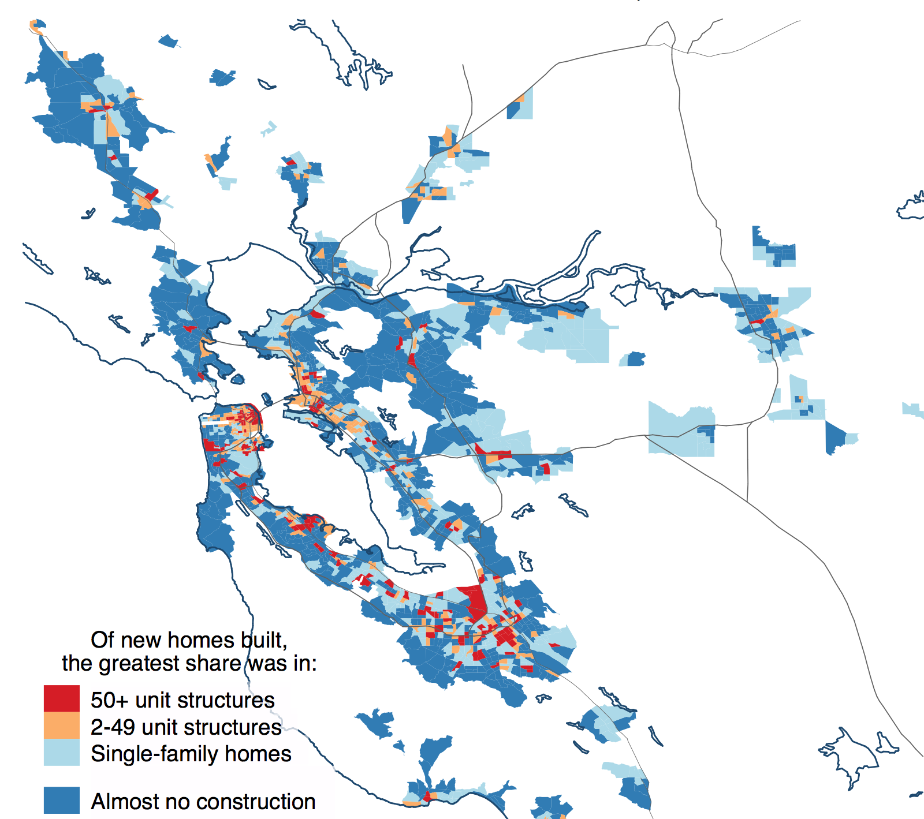
California has a housing crisis!
We only build two kinds of homes now
Dominant type of Housing Built, 2000-2016

Slide 7
Who Controls Housing?
State | Region/COG | Local | Non-governmental
Oversee setting and planning for housing goals
State Building Code
State Housing Law
Funding
Set housing goals for localities
Regional strategizing (CASA)
Direct Transit resources/planning
Long term planning for housing goals
Land use regulation and zoning
Entitlement - permitting and approval of projects
Local building codes and inspections
Local environmental regulations
Workforce and procurement rules
Infrastructure priorities
Development fees
Tenant policies
Funding
Historic designations
Labor and materials markets
Capital costs
Land supply and values

Slide 8
Who owns housing policy in California?
Stakeholders influence how we change (or stay the same)
Unions
Developers/Builders– Private and non-profit
Landowners
Realtors
Equity
Environmental
Municipalities
Special Districts
Residents/Voters

Slide 9
Terner California Residential Land Use Survey
Data collected between 2017-2018
Response rates:
  252 of 482 incorporated cities (52%)
  19 of 57 county unincorporated areas (33%)
Responses represent jurisdictions encompassing 70% of the state population

Slide 10
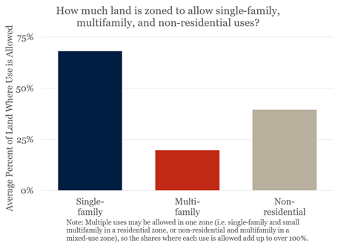
Localities zone less land for multifamily uses than for single family or non-residential uses

Slide 11
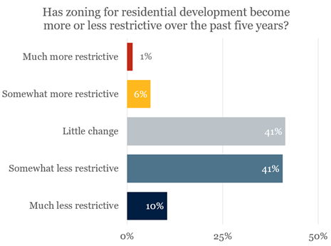
About half of localities maintained their zoning or made it more restrictive over the past five years

Slide 12
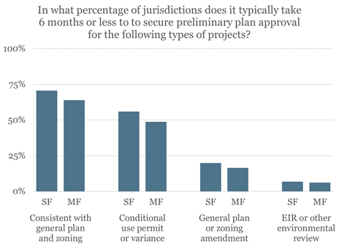
Localities often need more time to approve projects that diverge from current zoning

Slide 13
Questions and Feedback

